Slide 1


P5.js and Cordova
https://p5js.org/download/
https://cordova.apache.org/

Slide 2
p5.js is a JavaScript library
Creative coding for artists, designers, educators
Using the metaphor of a sketch
Has a full set of drawing functionality
Can include HTML5 objects for text, input, video, webcam, and sound

Slide 3

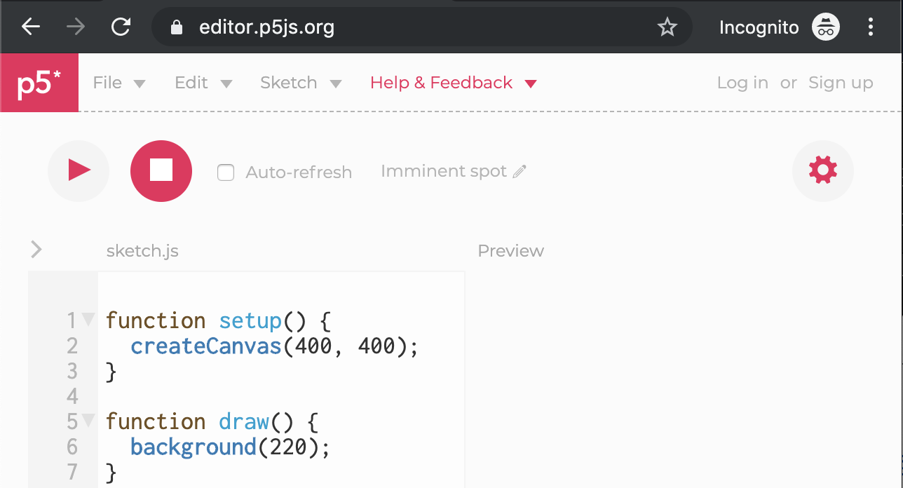
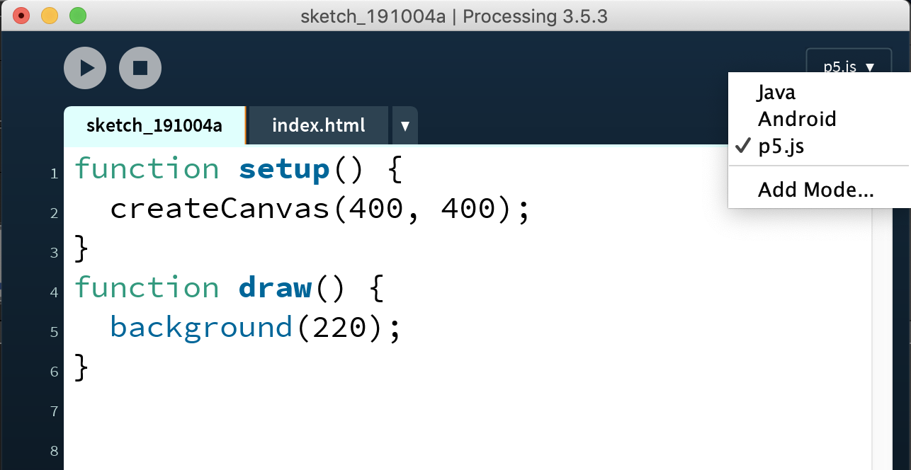
IDEs https://p5js.org/download/

Slide 4
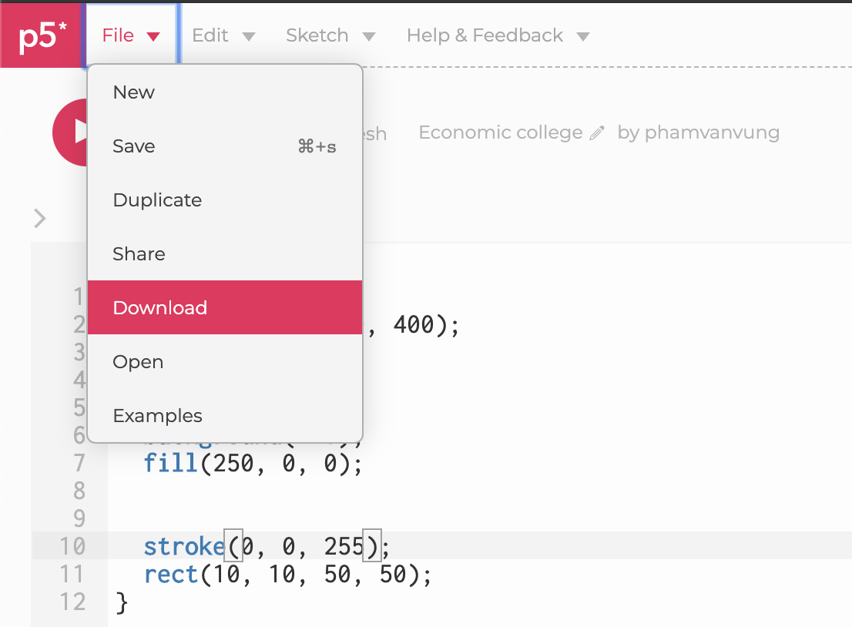
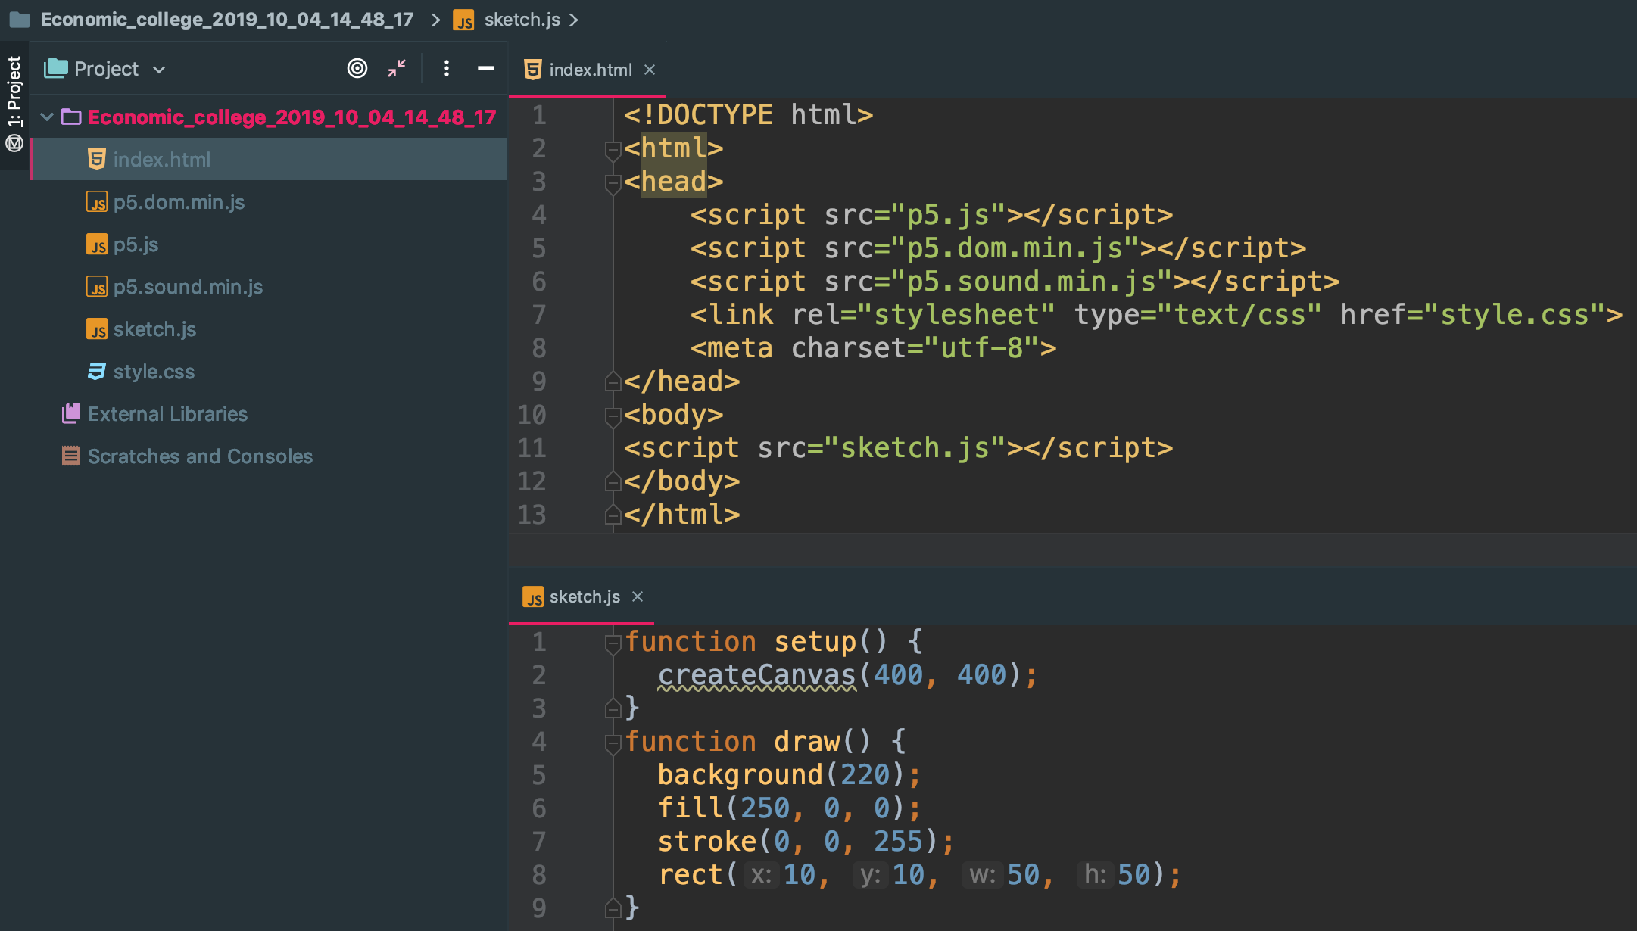
p5.js project structure
1
3
4
2
5

Slide 5
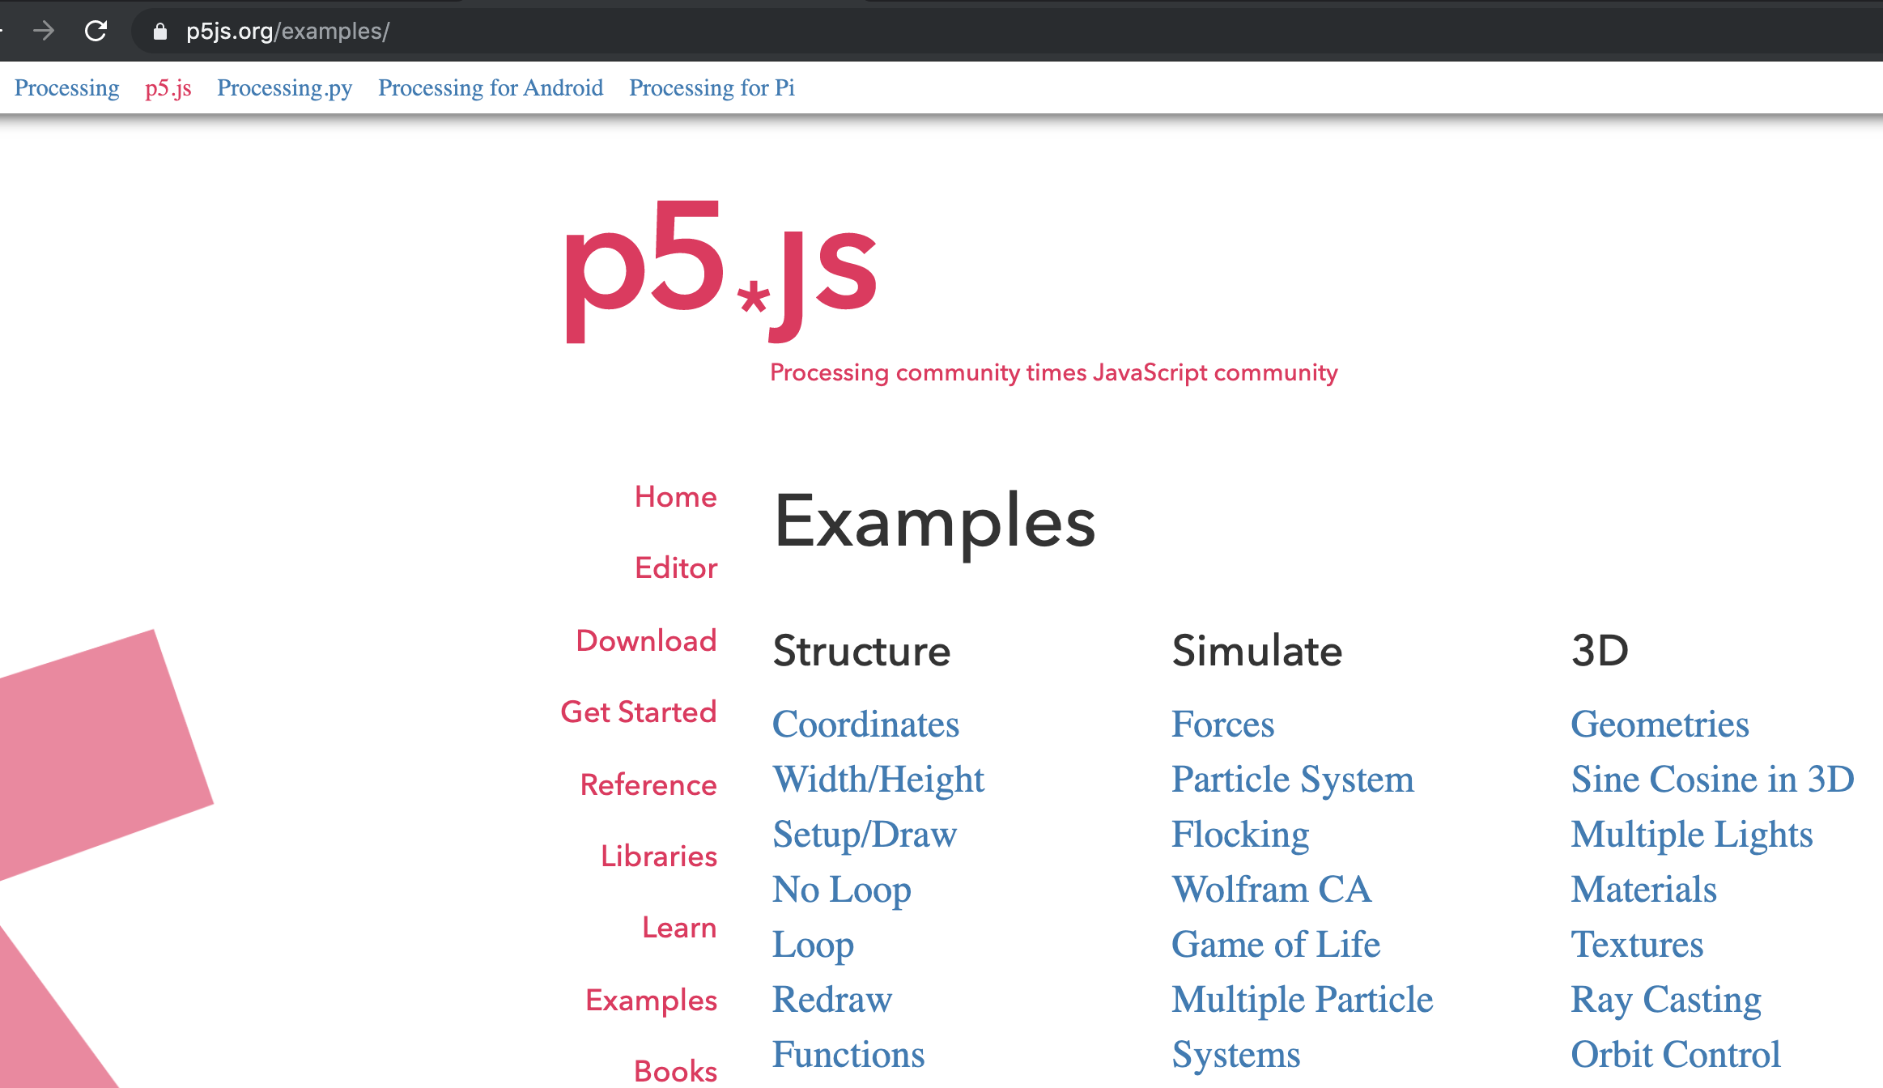


Slide 6

ACCESSING NATIVE FEATURES

Slide 7
Installation
https://nodejs.org/en/download
Run-time environment for JavaScript
Built on top of Google’s V8 engine
Used to execute JavaScript on any platform that Node.js can be installed

Slide 8
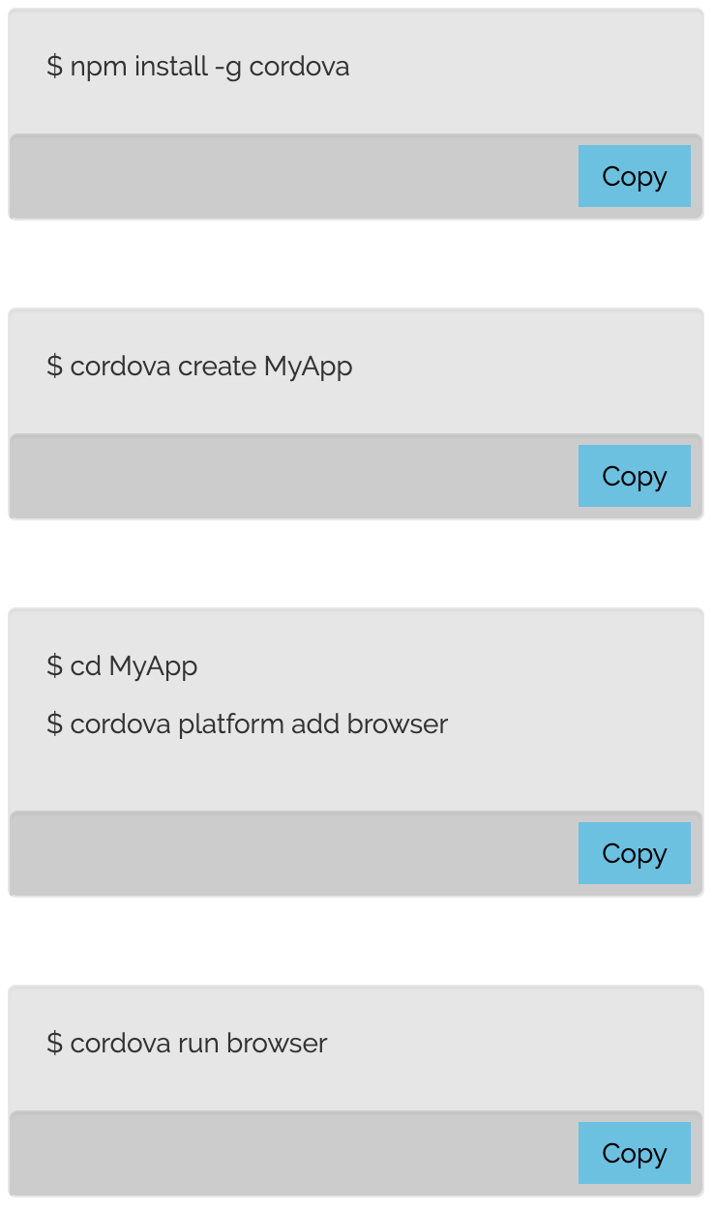

CORDOVA project structure

Slide 9
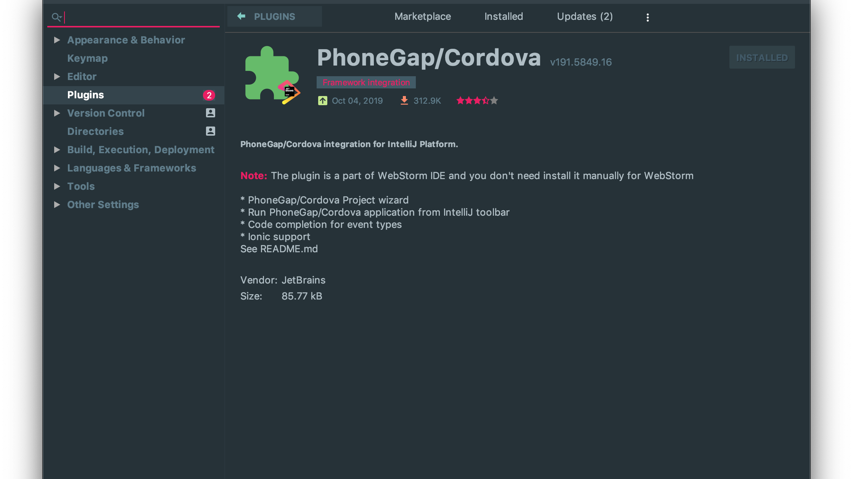
CORDOVA IDE plugin

Slide 10
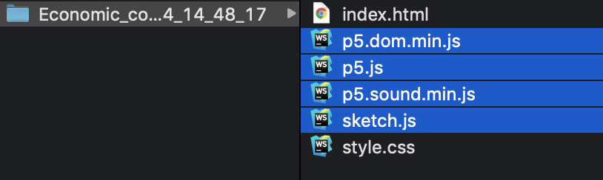
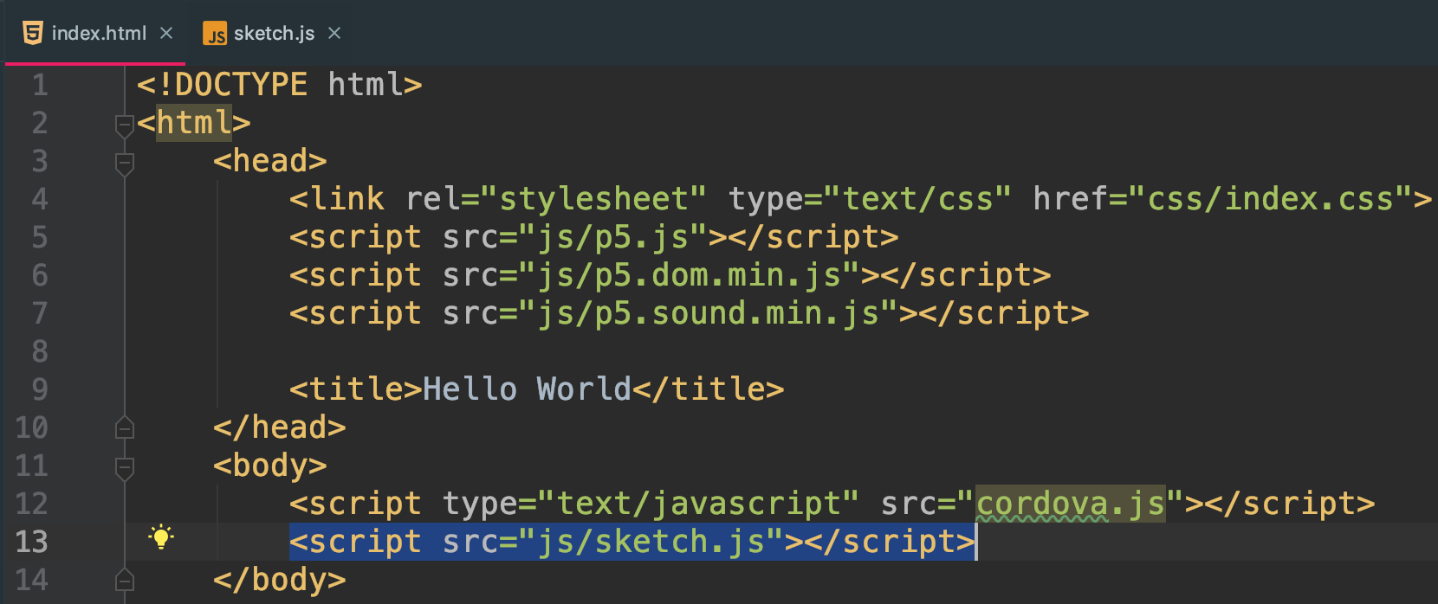
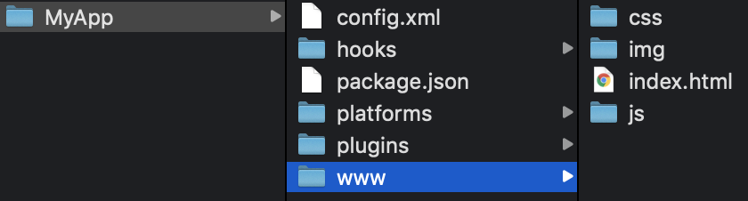
Combine the two projects
copy
combine

Slide 11

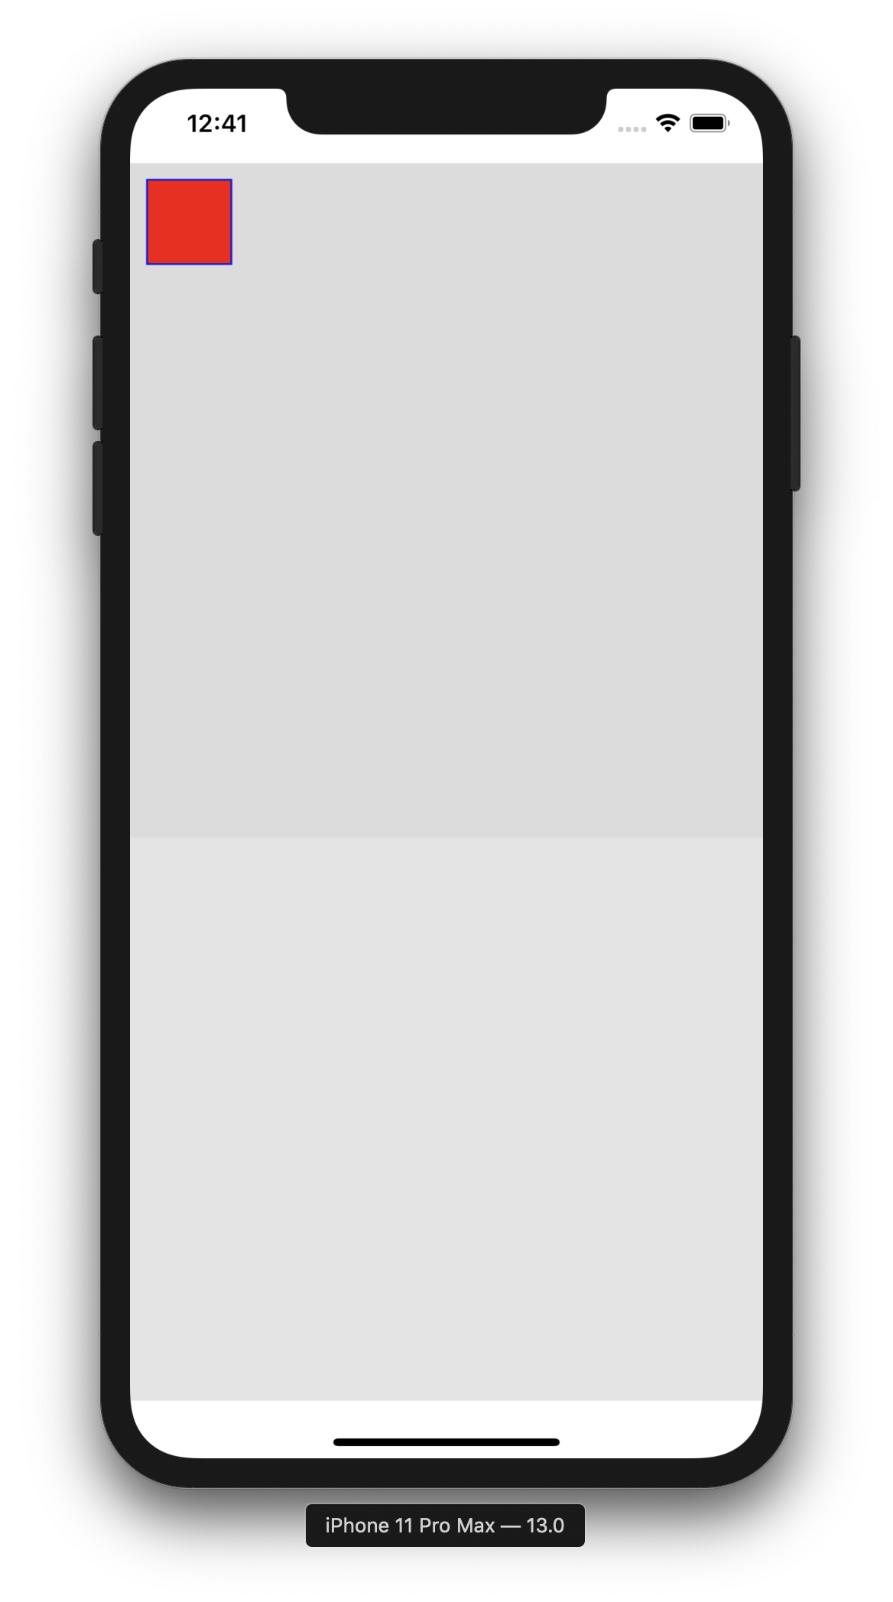

Slide 12
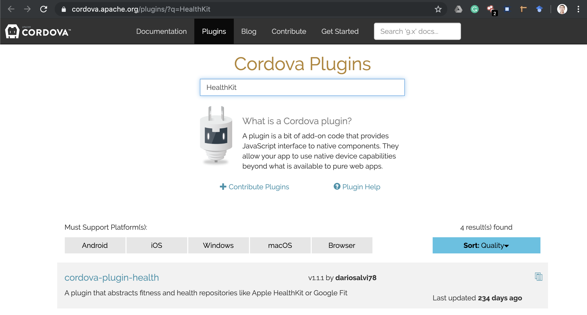
Search for the plugin

Slide 13
